Slide 1
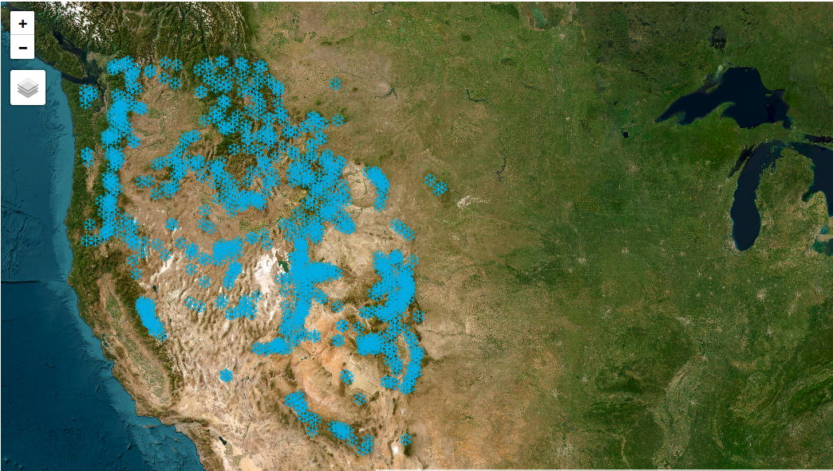
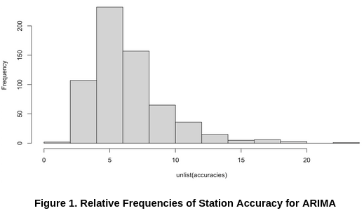
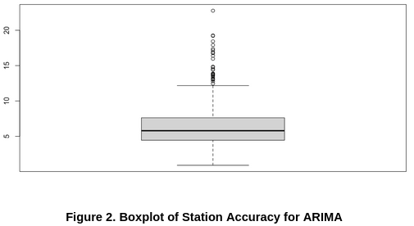
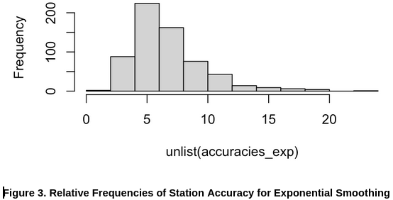
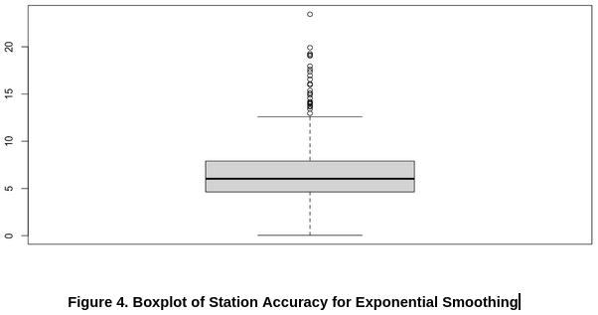
POW: Forecasting Snow Water Equivalent
Abstract
We use daily time-series measurements of snow water equivalent (SWE) to predict future SWE values as a proxy for drought and flood risk. As a metric, SWE is used by hydrologists, policy-makers, and others to estimate the availability of water resources, as an important input in river and flood planning, reservoir management, and much more. We use the ARIMA time-series forecasting method to predict the future SWE values given the time-series for each of 629 stations across the western United States.
Problem Space
Snow Water Equivalent (SWE)
Used by hydrologists and policy makers to assess drought and flood risk. Also used to determine availability of water resources.
Time Series Forecasting
Since we have daily, sequential data for SWE we use time series forecasting to predict future values.
Data
We obtained 10 years (1/1/2013-12/31/2022) of daily snow water equivalent readings from 837 SNOTEL sites across the western United States.
Filtered to 629 due to incomplete data in some stations
SNOTEL is an automated system of snowpack and other related climate sensors operated by the National Resources Conservation Service (NRCS)
Snow water equivalent is the depth of water that would cover the ground if all of the snow cover were suddenly in the liquid state in cubic-centimeters cm^3.
Snow water equivalent is an input to other important models, for example river forecasting models.
Developed tools to allow us to map stations to locations, to extract other metadata about the sites, and to collate the data by station and by year.
Methodology
Our data is sequential and only contains SWE values, so we used two well-known models that were suitable for time-series data, namely:
ARIMA time-series analysis
Exponential Smoothing
We Verified stationarity using the Augmented Dickey-Fuller (ADF) test.
Null hypothesis of the ADF test is that the time-series is non-stationary.
Sites with p values above 0.05 require differencing to achieve stationarity
Results
Average RMSE for ARIMA models: 6.411
Average RMSE for exponential smoothing models: 6.672
Both distributions centered around 5-10 with significant right skew and upward outliers
ARIMA expected to be slightly better for stationary data with short term trends, so results not surprising
Figure 5. SNOTEL Sites
Differencing
Subtracting the previous value from each day’s value to remove long term trends
Long term trends could be caused by macro factors like climate change and wind patterns
Further Exploration
More time series models (RNNs and LSTMs)
Test different hyperparameters (p, q, P, and Q) for ARIMA
Using geographically similar stations in the same model so more data is available.

